Slide 1



Python 3 Beginner
Chapter 00
Previously, on Python 3 Beginner…
release 1.0.0
37/39 Avenue Ledru Rollin – CS 11237 – 75750 PARIS CEDEX 12 - info@valnaos.com – www.valnaos.com Tél : 01 86 95 20 48

Slide 2

What we saw last time
Python 3 Beginner
L

Slide 3

Cloud Technology Associate
Copyright © 2018 | 9
Q&A
37/39 Avenue Ledru Rollin – CS 11237 – 75750 PARIS CEDEX 12 - info@valnaos.com – www.valnaos.com Tél : 01 86 95 20 48

Slide 4

Where? Who?
Python 3 Beginner
Class Material
GitHub: https://github.com/cstar-industries/python-3-beginner
Instructor
Charles Francoise <charles@cstar.io>

Slide 5

Session Objectives
Python 3 Beginner
At the end of this session, you will be able to:
De

Slide 6
Session Syllabus
Python 3 Beginner
Chapter | Subject | Start | End | Total Time (in hours)
00 | Previously on Python 3 Beginner… | 14:00 | 14:15 | 00:15
01 | Functions: Part I | 14:15 | 15:00 | 00:45
 | Coffee Break | 15:00 | 15:10 | 00:10
02 | Functions: Part II | 15:10 | 15:55 | 00:45
 | Coffee Break | 15:55 | 16:05 | 00:10
03 | Generators and Error Handling | 16:05 | 16:50 | 00:45
 | Coffee Break | 16:50 | 17:00 | 00:10
 | Workshop | 17:00 | 18:00 | 01:00
 | Total |  |  | 04:00

Slide 7
Python 3 Beginner
Chapter 01
A guided tour of the Python Standard Library
release 1.0.0
37/39 Avenue Ledru Rollin – CS 11237 – 75750 PARIS CEDEX 12 - info@valnaos.com – www.valnaos.com Tél : 01 86 95 20 48

Slide 8
Dealing with files: opening
Python 3 Beginner
Open a file using the built-in function open
f = open('hello.txt')
print(f.read())
f.close()
hello
Opening a file can fail: remember to catch errors
f = open('hello.txtx')
FileNotFoundError: [Errno 2] No such file or directory: 'hello.txtx'

Slide 9
Dealing with files: opening
Python 3 Beginner
An open file should always be closed
f = open('hello.txt')
...
f.close()
⚠️Errors can happen here
Use a with statement to make sure file is closed
with open('hello.txt') as f:
data = f.read()
print(f.closed)
True

Slide 10
Dealing with files: opening
Python 3 Beginner
By default, a file is not writable
with open('hello.txt') as f:
f.write('Hello World!')
UnsupportedOperation: not writable
Use the mode argument
with open('hello.txt', 'w') as f:
f.write('Hello World!')
"Write mode"

Slide 11
Dealing with files: opening
Python 3 Beginner
There are many modes to open a file
Character | Meaning
r | open for reading (default)
w | open for writing, truncating the file first
x | open for exclusive creation, failing if the file already exists
a | open for writing, appending to the end of the file if it exists
b | binary mode
t | text mode (default)
+ | open for updating (reading and writing)
Mode characters can be combined:
'r+b' opens the file for reading and writing in binary mode
See the documentation to learn more about open

Slide 12
Dealing with files: reading and writing
Python 3 Beginner
Read from a file with the read method
print(f.read(3)) # Number of bytes/characters to be read
print(f.read()) # Read to end of file
hel
lo
Write to a file with the write method
f.write('Hello ')
f.write('World!')
...
print(f.read())
Hello World!

Slide 13
Dealing with files: reading and writing
Python 3 Beginner
Move your cursor with the seek method and find out your current position with the tell method
f.seek(4)
print(f.tell())
print(f.read())
o
Find out more about files and file-like objects in the documentation

Slide 14
Let’s write some code!
Python 3 Beginner
with open('hello.txt', 'w') as f:
f.write('Hello World!')
with open('hello.txt') as f:
print(f.read())
Hello World!

Slide 15
Interacting with the operating system: the os module
Python 3 Beginner
import os
import os.path
The built-in os module provides a way to call operating system functions from Python
Environment variables
Filesystem operations
Process management
Cryptographically-secure random numbers
⚠️ Not all functions are portable between OSes (Linux, macOS, BSD, Windows...)
Find a comprehensive list of the os module in the documentation

Slide 16
Reading environment variables
Python 3 Beginner
You can list all variables defined in your current environment with os.environ
os.environ
environ{'TERM': 'xterm-256color',
'SHELL': '/bin/bash',
'TMPDIR': '/var/folders/_7/5ywmfgxn1v50w94f4bp5ql080000gn/T/',
'LC_ALL': 'en_US.UTF-8',
'USER': 'chrales',
...
Get the value of a single environment variable or a default value if it is undefined
os.getenv('USER', default='python')
'chrales'

Slide 17
Filesystem operations
Python 3 Beginner
List the contents of a directory
os.listdir()
['001-First-Steps', '004-Functions-And-More', '003-Data-Structures', 'README.md', '002-Control-Flow']
os.listdir('/bin')
['cat', 'echo', 'launchctl', 'df', 'pwd', 'test', 'csh', 'wait4path', 'unlink'...
Change the current directory
os.chdir('001-First-Steps')

Slide 18
Filesystem operations
Python 3 Beginner
Create a directory
os.mkdir('new-directory')
Remove a directory
os.rmdir('new-directory')
Rename (move) a file or directory
os.rename('hello.txt', 'hello-world.txt')
os.rename('hello.txt', '005-Python-Standard-Library/hello.txt')
Remove a file
os.remove('005-Python-Standard-Library/hello.txt')

Slide 19
Filesystem operations
Python 3 Beginner
Create a symbolic link (Windows "shortcut")
os.symlink('Shortcut to classes', '/home/chrales/Classes/python-3-beginner')
Reading a symbolic link
os.readlink('Shortcut to classes')
['cat', 'echo', 'launchctl', 'df', 'pwd', 'test', 'csh', 'wait4path', 'unlink'...

Slide 20
Filesystem operations
Python 3 Beginner
Query info about paths
os.path.exists('hello.txt')
True
print(os.path.isfile('hello.txt'))
print(os.path.isdir('hello.txt'))
True
False
os.path.getsize('hello.txt')
13

Slide 21
Filesystem operations
Python 3 Beginner
Extract path components
os.path.split('/home/chrales/Work/python-3-beginner/README.md')
('/home/chrales/Work/python-3-beginner', 'README.md')
print(os.path.dirname('/home/chrales/Work/python-3-beginner/README.md'))
print(os.path.basename('/home/chrales/Work/python-3-beginner/README.md'))
/home/chrales/Work/python-3-beginner
README.md
os.path.splitext('README.md')
('hello', '.txt')

Slide 22
Filesystem operations
Python 3 Beginner
Join path components
os.path.join('/home/chrales', 'Work', 'python-3-beginner', 'README.md')
'/home/chrales/Work/python-3-beginner/README.md'
Get the absolute canonical path (resolve symlinks, relative paths)
os.path.realpath('../python-3-beginner/README.md')
'/home/chrales/Work/python-3-beginner/README.md'

Slide 23
Let’s write some code!
Python 3 Beginner
with open('hello.txt', 'w') as f:
f.write('Hello World!')
with open('hello.txt') as f:
print(f.read())
Hello World!

Slide 24
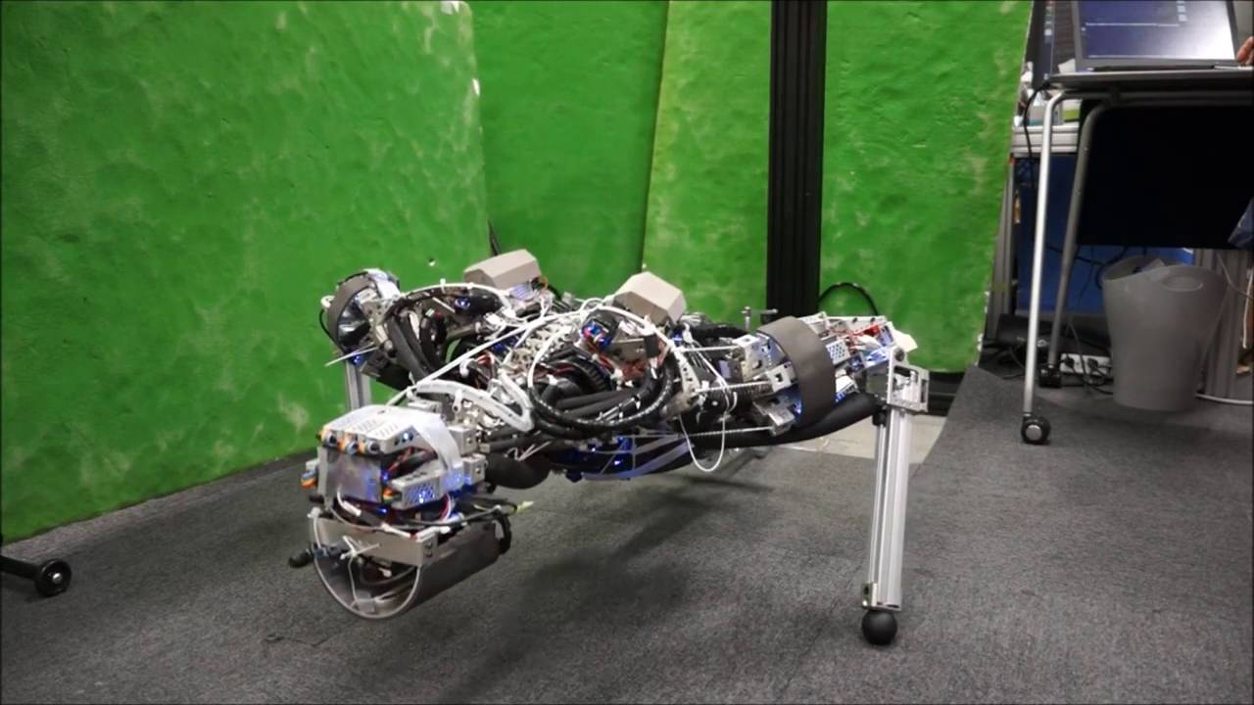
Workout Time!
Python 3 Beginner
Notes:
https://github.com/cstar-industries/python-3-beginner/blob/master/001-First-Steps/First%20Steps%20-%20Chap%2001%20-%20Exercises.ipynb

Slide 25
Regular expressions: the re module
Python 3 Beginner
import re
The built-in re module provides regular expression matching operations
Find out more about the re module in the documentation
Learn about regular expressions at https://regexone.com
Play regular expressions crosswords at https://regexcrossword.com
Test and debug your regular expressions at https://regex101.com

Slide 26
Regular expressions: the re module
Python 3 Beginner
Match a regex in a string
m = re.match(r'a+b', 'aaaab')
print(m)
<re.Match object; span=(0, 5), match='aaaab'>
m = re.match(r'a+b', 'baba')
print(m)
None
m = re.search(r'a+b', 'baba')
print(m)
<re.Match object; span=(1, 3), match='ab'>

Slide 27
Regular expressions: the re module
Python 3 Beginner
Replace ("substitute") occurrences of a regex
re.sub(r'a+', 'a', 'aaaaa-aaa-aaaaaa-a-bbb')
'a-a-a-a-bbb'
re.sub(r'\D', '', '(460)190-2235')
'4601902235'
Split a string using a regular expression
re.split(r'[-_/]', 'hello-world/python_rocks')
['hello', 'world', 'python', 'rocks']

Slide 28
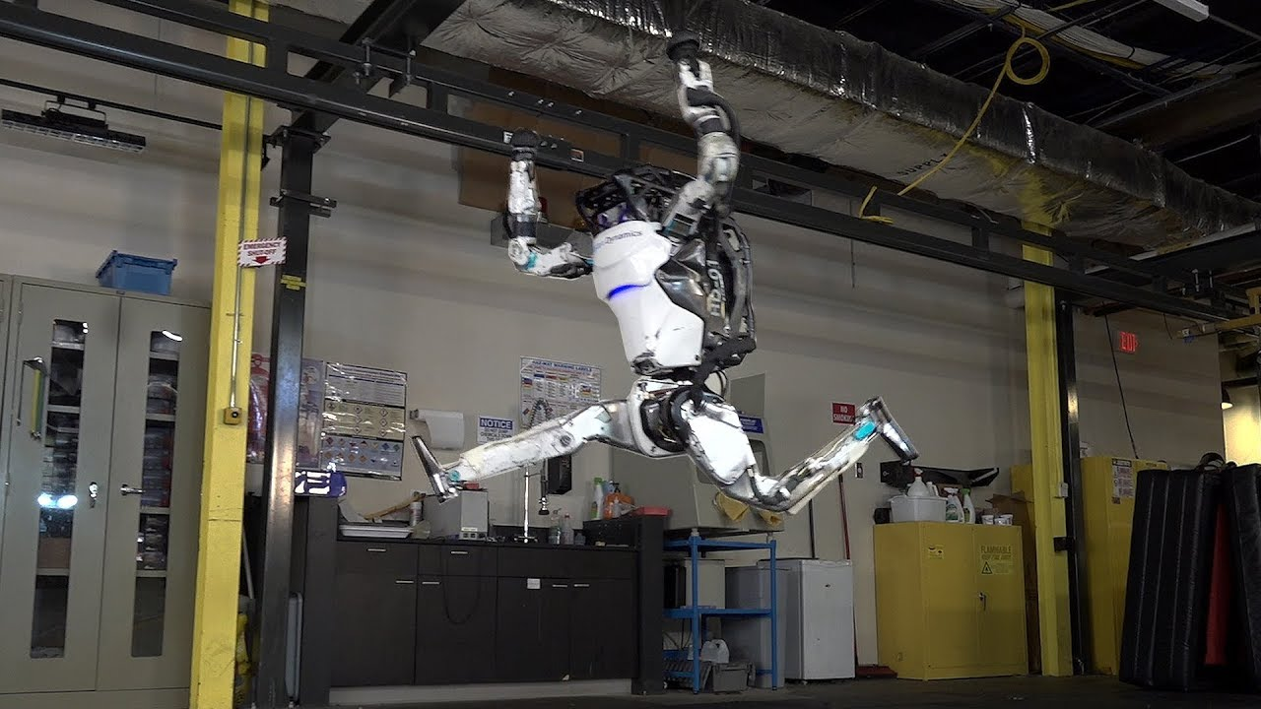
Workout Time!
Python 3 Beginner
Notes:
https://github.com/cstar-industries/python-3-beginner/blob/master/001-First-Steps/First%20Steps%20-%20Chap%2002%20-%20Exercises.ipynb

Slide 29
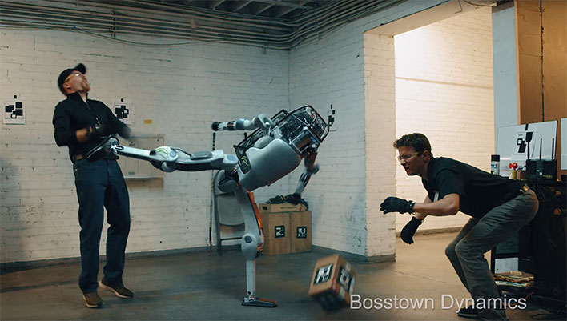
Workout Time!
Python 3 Beginner
Notes:
https://github.com/cstar-industries/python-3-beginner/blob/master/001-First-Steps/First%20Steps%20-%20Chap%2003%20-%20Exercises.ipynb

Slide 30
Chapter Summary
Python 3 Beginner
In this chapter, we learned how about:
Default arguments to simplify function calls in the most current cases
Keyword arguments to make function calls more explicit
Variable argument lists (*args, **kwargs)
Unpacking a sequence type into arguments in a function call
Variable scope inside and outside a function
Mutability inside a function

Slide 31
Cloud Technology Associate
Copyright © 2018 | 9
Q&A
37/39 Avenue Ledru Rollin – CS 11237 – 75750 PARIS CEDEX 12 - info@valnaos.com – www.valnaos.com Tél : 01 86 95 20 48

Slide 32
Workshop
Python 3 Beginner
Notes:
https://github.com/cstar-industries/python-3-beginner/blob/master/001-First-Steps/First%20Steps%20-%20Workshop.ipynb

Slide 33
Thank you for your attention!

